Slide 1


Slide 2
INTERDISCIPLINARY DOCTORAL PROGRAMME BIOMEDICINE

Slide 3
PROGRAMME PROVIDERS
5 FACULTIES:
UL Biotechnical Faculty
UL Faculty of Pharmacy
UL Faculty of Chemistry and Chemical Technology
UL Faculty of Medicine
UL Veterinary Faculty
3 RESEARCH INSTITUTES:
Jožef Stefan Institute
National Institute of Chemistry
National Institute of Biology

Slide 4
SCIENTIFIC FIELDS
Basic Medicine
Biochemistry and Molecular Biology
Clinical Biochemistry and Laboratory Biomedicine
Clinical Medicine
Genetics
Medical Microbiology
Neuroscience
Pharmacy
Public Health
Toxicology
Veterinary Medicine

Slide 5
ABOUT THE PROGRAMME
Scientific title:
Doctor of Philosophy, Ph.D.
Official length of the study programme:
Four years – 240 ECTS

Slide 6
BASIC PROGRAMME GOALS
To educate highly qualified experts for the purposes of:
finding employment in highly demanding and responsible positions;
performing creative and independent scientific research work, including international projects;
solving scientific problems with an interdisciplinary approach;
critically assessing research results;
developing new research methods and transferring knowledge into practice.

Slide 7
ADMISSION REQUIREMENTS
Graduates of:
Second cycle study programmes.
Study programmes evaluated with at least 300 credits.
Study programmes leading to specialisation, provided that candidates have previously completed a higher education professional study programme. The Statistics Programme Council will specify additional entry requirements for candidates in individual areas amounting from 30 to 60 credits.
Study programmes leading to a master of science or to specialisation after completing academic study programme. 60 credits of study obligations will be recognised to such candidates.
Academic study programmes.
Candidates with foreign qualifications are obliged to acquire a decision on recognition of foreign education. The recognition procedure is a part of the enrolment procedure.

Slide 8
ACADEMIC YEAR 2024/2025
Enrolment places: 160
Application Deadline: 28 July 2024, 23:59 (CEST) via the eVŠ web portal: http://portal.evs.gov.si/prijava/
Choose the mentor and submit a brief concept of research work before enrolment.
Tuition fee: 14,600.00 € for the whole programme:
  Year 1: 4,700.00 €
  Year 2: 4,700.00 €
  Year 3: 2,600.00 €
  Year 4: 2,600.00 €

Slide 9
CURRICULUM
Year 1 | ECTS | Year 2 | ECTS | Year 3 | ECTS | Year 4 | ECTS
Core Courses | 30 | Elective Course 1 | 5 | Independent Research Work 3 | 60 | Independent Research Work 4 | 50
Independent Research Work 1 | 30 | Elective Course 2 | 5 |  |  | Presentation of Results of Research Work | 5
 |  | Elective Course 3 | 5 |  |  | Completed Doctoral Dissertation and PhD Viva | 5
 |  | Presentation of the Doctoral Dissertation Proposal | 5
 |  | Independent Research Work 2 | 40

Slide 10
CAREER PROSPECTS
Education or research institutes;
Pharmaceutical industry;
Health institutes;
Public administration;
Government offices;
Corporations and smaller companies dealing with research;
Other institutions that employ experts and researchers with the highest level of education.

Slide 11
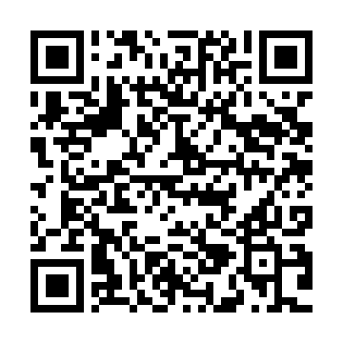
FURTHER INFORMATION
Website:
http://www.uni-lj.si/study/doctoral/biomedicine/
Contacts:
Student offices at the participating faculties
and
doktorski.studij@uni-lj.si

